Slide 1

LORENTZ FORCE AND HALL EFFECT
FISIKA DASAR 2

Slide 2
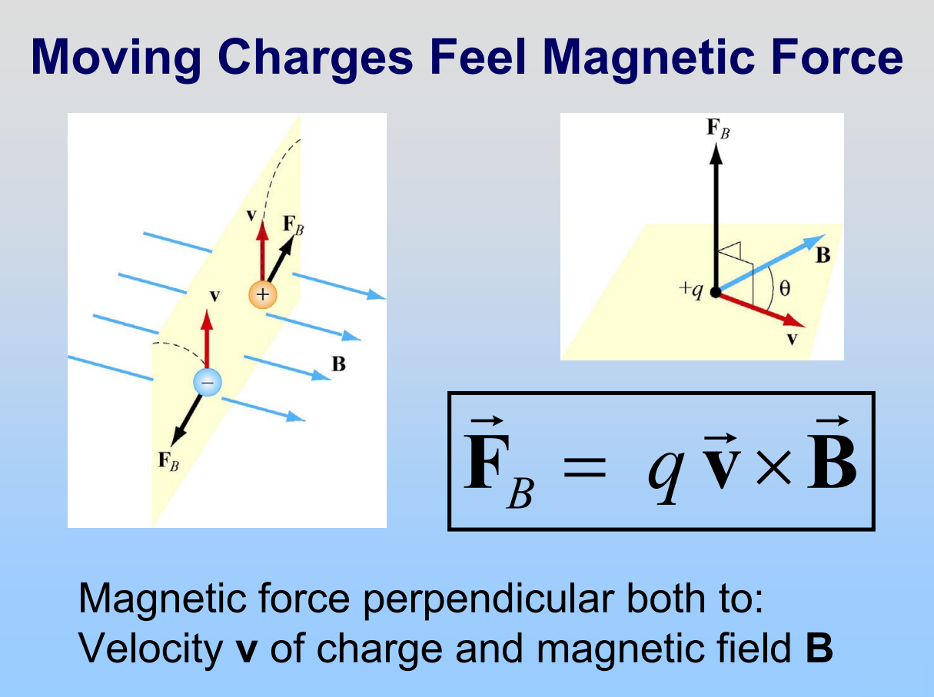

Adopted from MIT Course
2

Slide 3
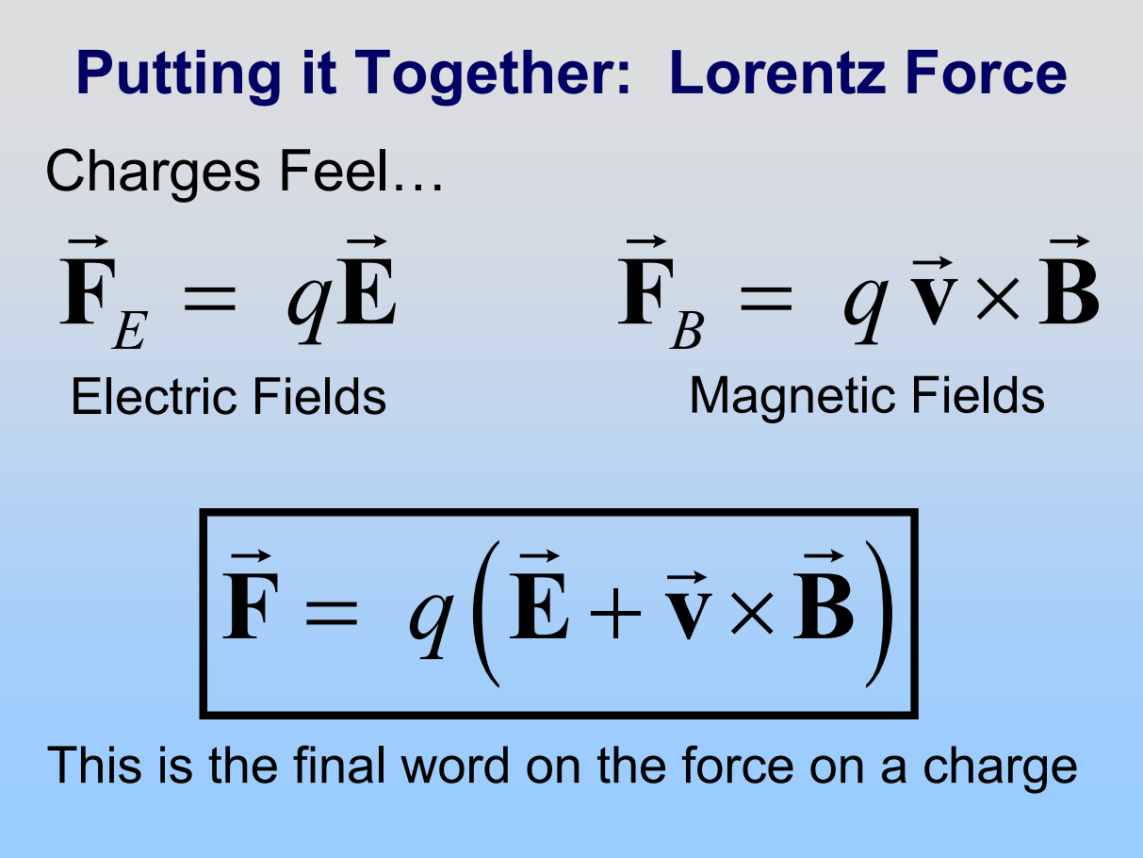
Adopted from MIT Course
3

Slide 4
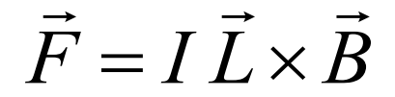
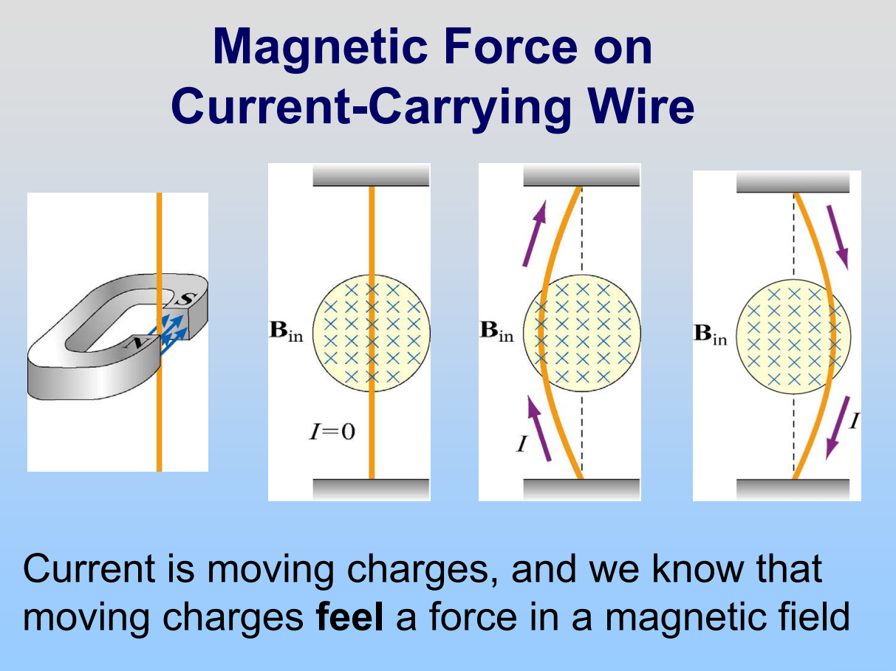
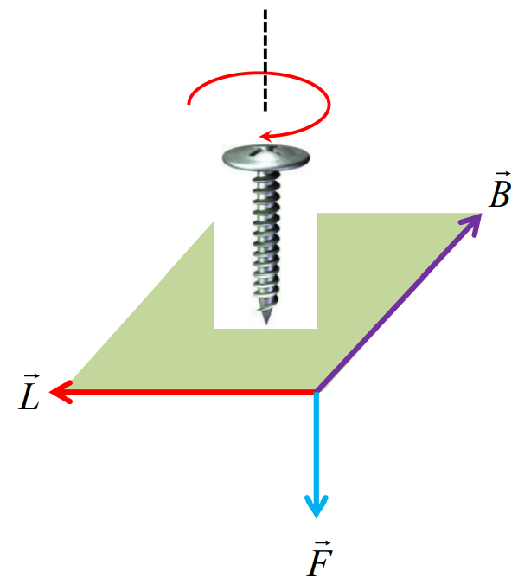

Gambar: Fisika Dasar 2, Prof. Mikrajuddin Abdullah, Penerbit ITB
Adopted from MIT Course
4

Slide 5
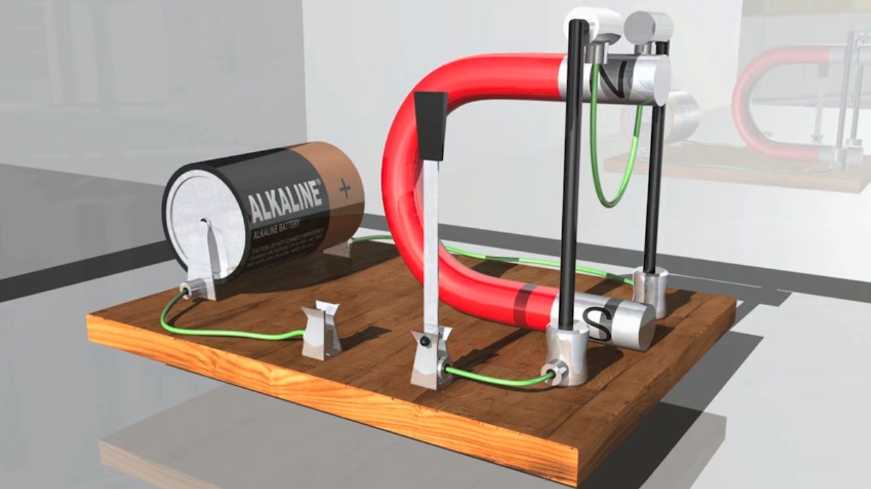
The Lorentz Force Simulation
https://www.youtube.com/watch?v=nRDVm5rn_2A
5

Slide 6
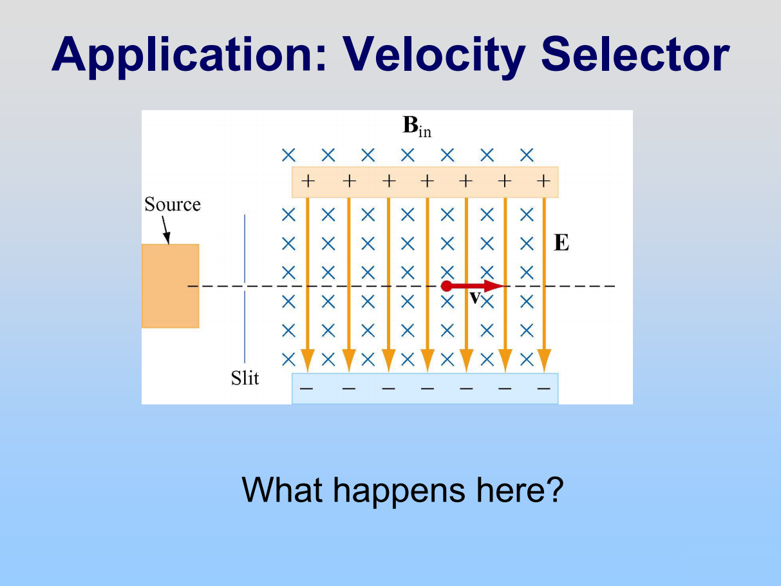
Adopted from MIT Course
6

Slide 7
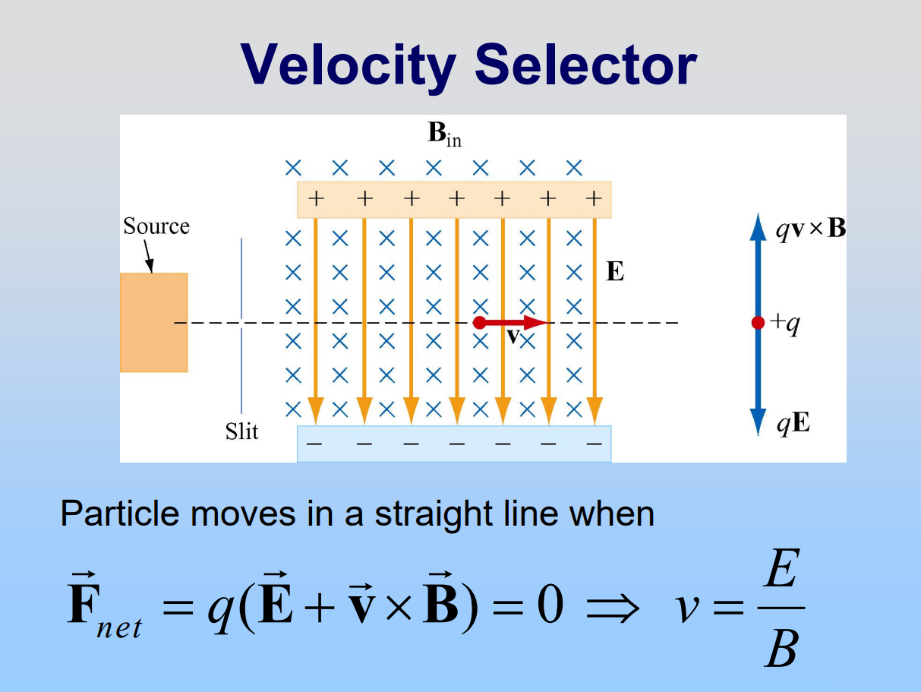
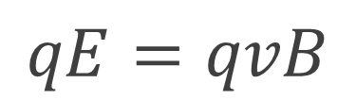
$$qE=qvB$$
Adopted from MIT Course
7

Slide 8
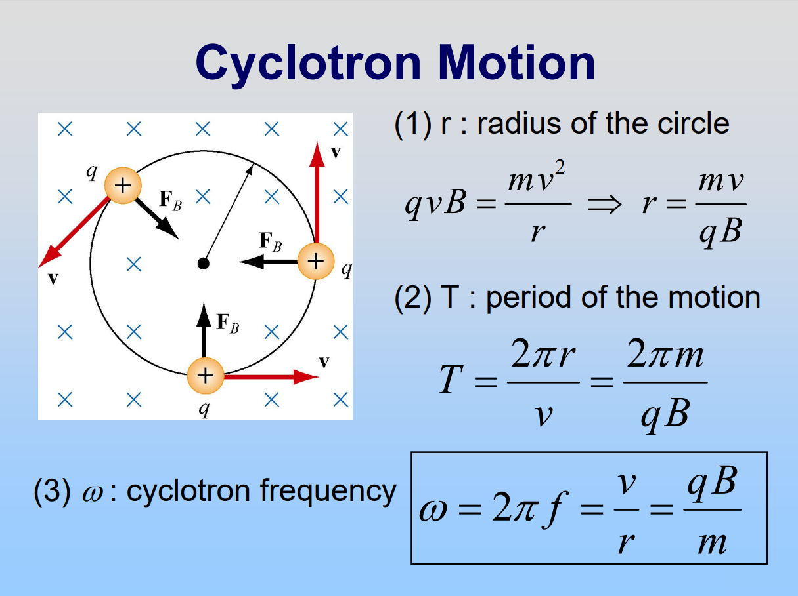
Adopted from MIT Course
8

Slide 9
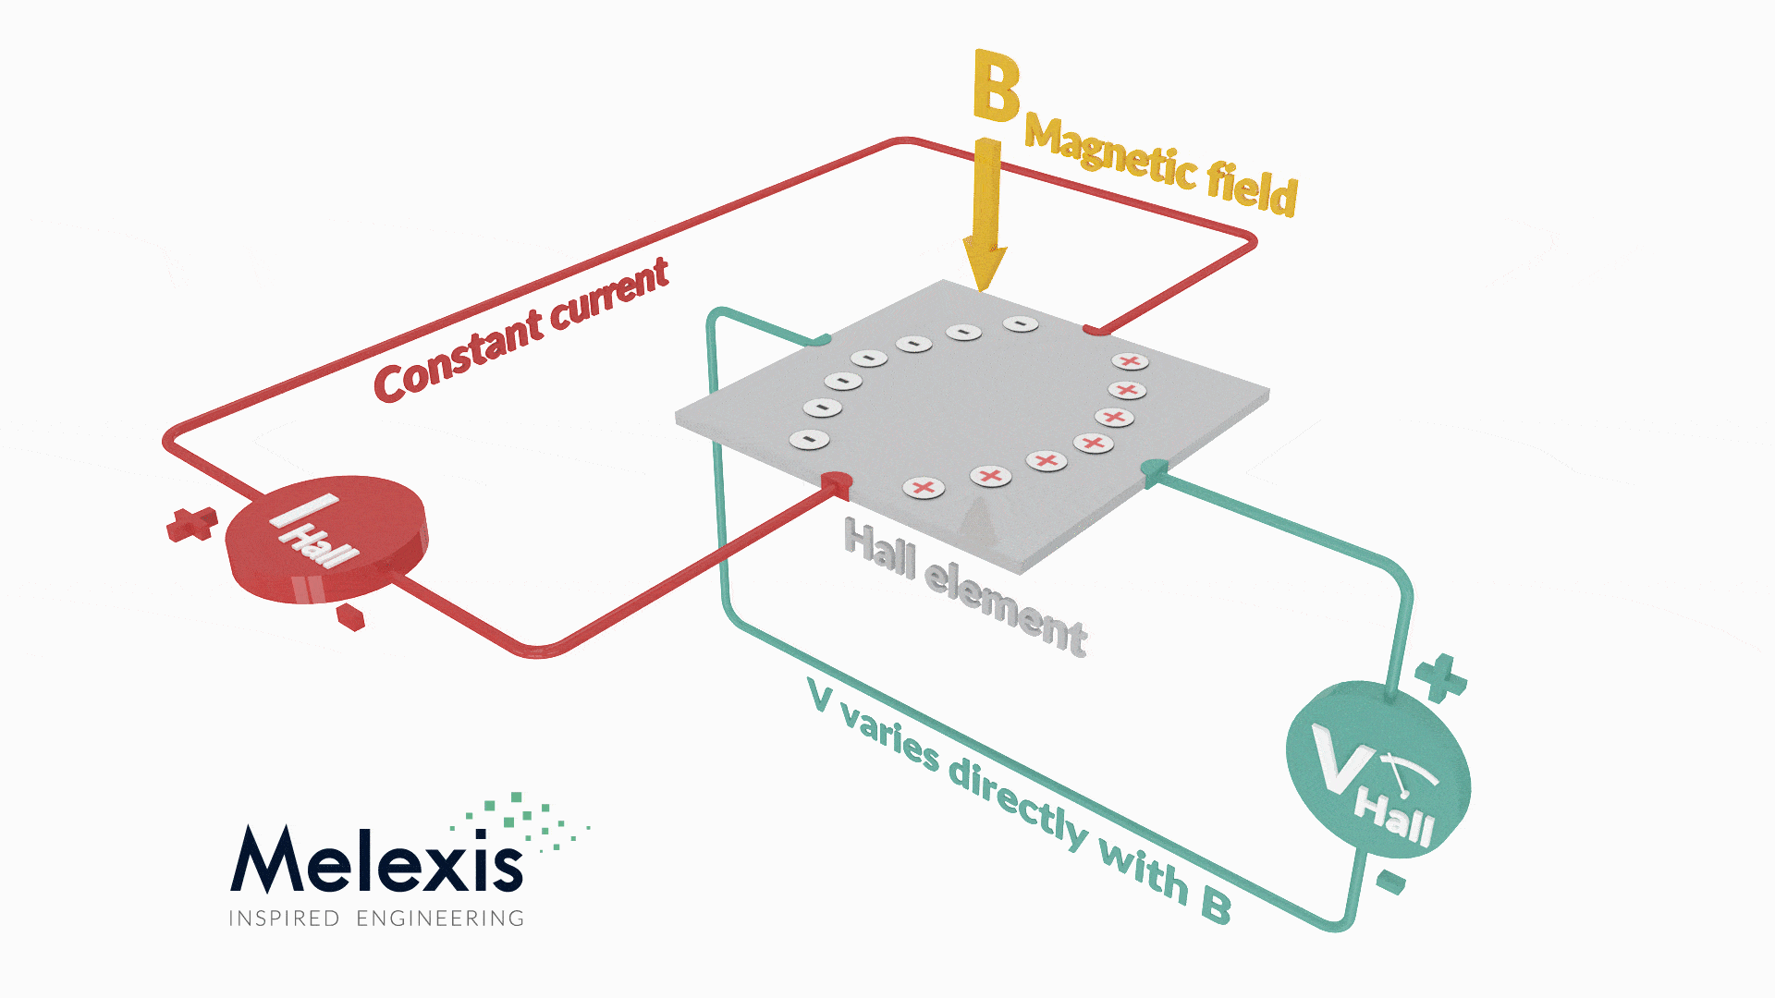
Hall Effect Animation
https://www.melexis.com/en/tech-talks/hall-effect
9

Slide 10
SEKIAN - TERIMAKASIH

